Slide 1
AI-Driven Crop Disease Detection

Slide 2
Team Details
PARTICIPANTS :
BHARATH R
LOHITH S
PAVITHRA GV
K SAI CHARAN
FROM :
SRM INSTITUTE OF SCIENCE AND TECHNOLOGY, KATTANKULATHUR, CHENNAI

Slide 3
Theme :
AI-Driven Crop Disease Detection
(AI/ML)

Slide 4
Problem Statement
Farmers worldwide have a crucial problem in detecting and combating crop illnesses early enough to avoid severe output loss. Traditional illness detection methods rely mainly on specialists' visual inspections, which are time-consuming, subjective, and prone to inaccuracy. In large agricultural areas, this strategy becomes increasingly problematic, resulting in delayed intervention and lower productivity.
The reliance on human inspection restricts disease identification's scalability and accessibility, especially for small-scale farmers and those living in rural areas with little access to agricultural knowledge. Furthermore, the subjective nature of visual examination increases unpredictability and inconsistency in illness diagnosis, which impedes efficient management techniques.

Slide 5
Proposed Solution
1. Image Processing and Analysis: The foundation of our approach is the creation of AI algorithms for picture processing and analysis. Farmers may take photos of their crops using basic cellphones or cameras. These photographs are subsequently sent to a centralized platform or mobile application. 2. Machine Learning Models: On the backend, machine learning models are trained to evaluate submitted photos and identify crop illnesses. We use deep learning techniques like convolutional neural networks (CNNs) to extract characteristics from photos and categorize them into illness categories.
3.Disease Classification and Diagnosis: The trained models categorize the submitted photos according to the presence of disease
symptoms. By comparing the processed photos to a database of known agricultural illnesses, the technology gives farmers with
real-time feedback on disease prevalence and severity.

Slide 6
4. Actionable Insights and suggestions: When the system detects a possible crop disease, it provides farmers with actionable insights and suggestions. These recommendations might include proposed treatment actions including using certain insecticides or fungicides,
modifying irrigation procedures, or establishing crop rotation schemes.
5. User-Friendly Interface: The solution has a user-friendly interface that can be accessed via online or mobile apps. Farmers may quickly upload pictures, evaluate analysis findings, and get individualized crop disease management suggestion. The interface is intended to be straightforward and requires little technical knowledge to operate efficiently.
6. Scalability and Accessibility: Our software-based solution is both scalable and accessible, making it appropriate for farmers of various sizes and geographic regions. The system may be put on a cloud-based architecture, making it accessible via web browsers or mobile devices.
7. Continuous Improvement: The system is intended to continually learn and improve over time. As additional data is gathered and evaluated, machine learning models are retrained to improve their accuracy and efficacy in illness detection and treatment.

Slide 7
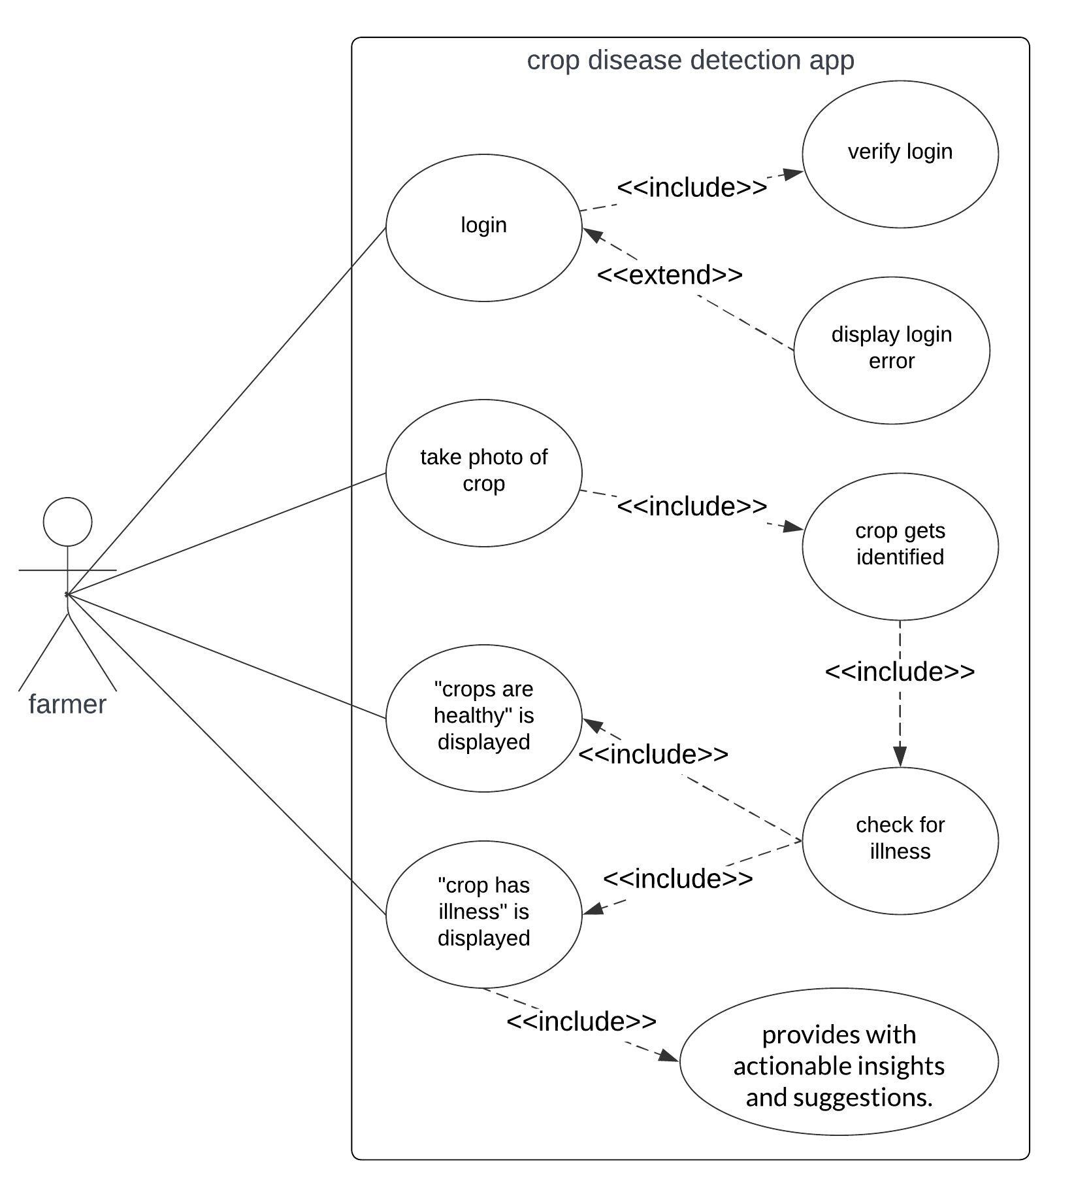
Use-Case Diagram

Slide 8
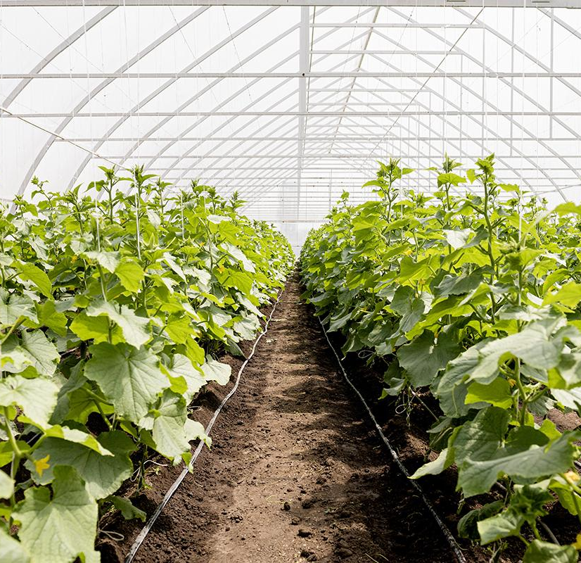
Tech Stack
Front-end: React.js, HTML CSS
Back-end: Python
APIs: Agricultural APIs (e.g., USDA API)
Cloud Service Providers: AWS

Slide 9
Potential Impact
1. Increased Crop output: Early diagnosis and control of crop diseases can avert large output losses, resulting in a more stable food supply and fewer food shortages. 2. Improved Food Security: By reducing crop losses due to disease, the AI-powered system can help to improve food security, particularly in areas prone to agricultural problems and food instability. 3. Sustainable Agriculture: By optimizing resource consumption through targeted interventions based on AI analysis, we may encourage sustainable farming methods while lowering the need for chemical inputs and minimizing environmental damage.
4.Technological Advancement in Agriculture: The use of modern technologies like AI in agriculture promotes innovation and technical advancement in the industry, opening the way for future innovations and improvements in agricultural
methods.

